Slide 1
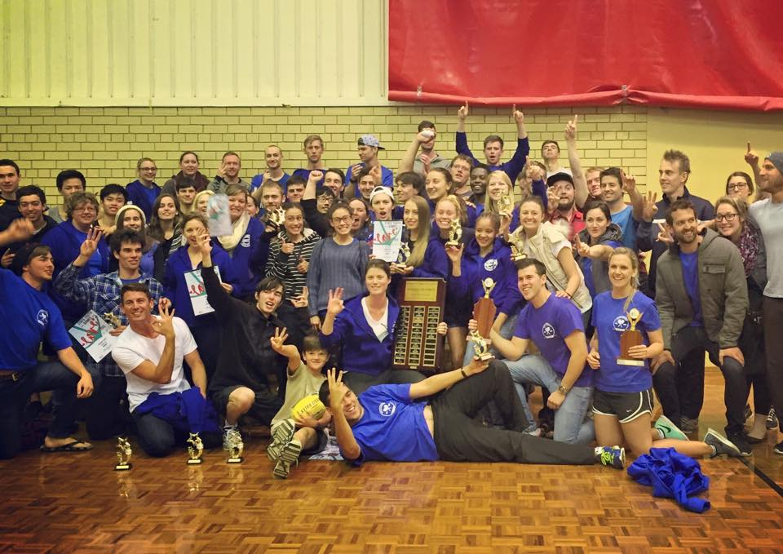

Slide 2
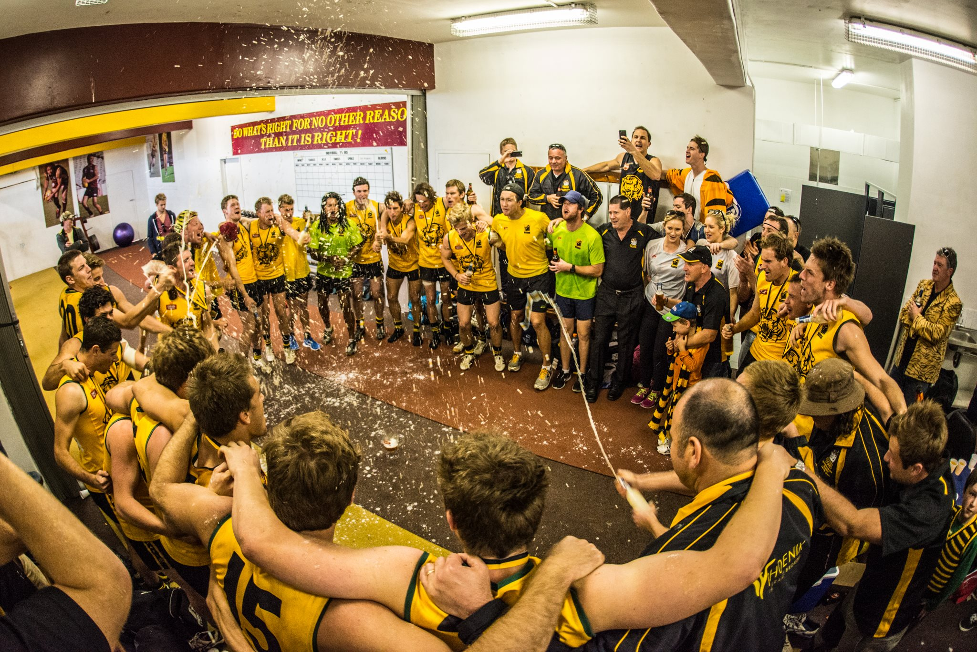

Slide 3
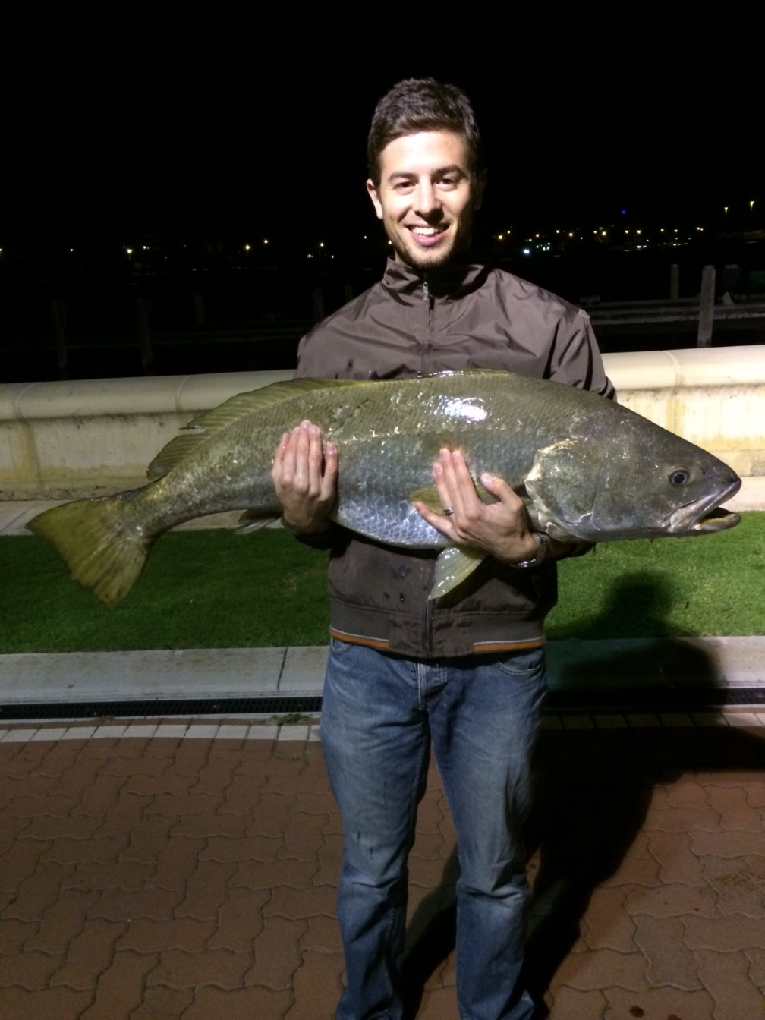

Slide 5
Is it possible that there’s a trophy to work towards that lasts forever?

Slide 6
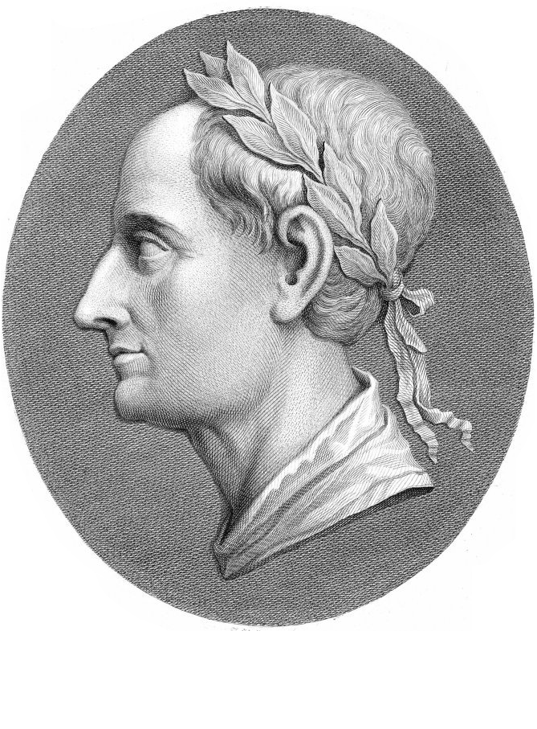
Do you not know that in a race all the runners run, but only one gets the prize? Run in such a way as to get the prize. Everyone who competes in the games goes into strict training. They do it to get a crown that will not last, but we do it to get a crown that will last forever. 1 Corinthians 9:24-25 (NIV)

Slide 7
Though I am free and belong to no man, I make myself a slave to everyone, to win as many as possible. To the Jews I became like a Jew, to win the Jews. To those under the law I became like one under the law (though I myself am not under the law).
To those not having the law I became like one not having the law (though I am not free from God’s law but am under Christ’s law), so as to win those not having the law. To the weak I became the weak, to win the weak.
I have become all things to all men so that by all possible means I might save some. I do all this for the sake of the gospel, that I may share in it’s blessings. 1 Corinthians 9:19-23 (NIV)

Slide 8
Our eternal crown is not just our eternal life, but the salvation and faith of people we invest our lives in.

Slide 10
Since, then, you have been raised with Christ, set your hearts on things above, where Christ is seated at the right hand of God. Set your minds on things above, not on earthly things. For you died, and your life is now hidden with Christ in God. When Christ, who is your life, appears, then you also will appear with him in glory. Colossians 3:1-4 (NIV)

